Slide 1
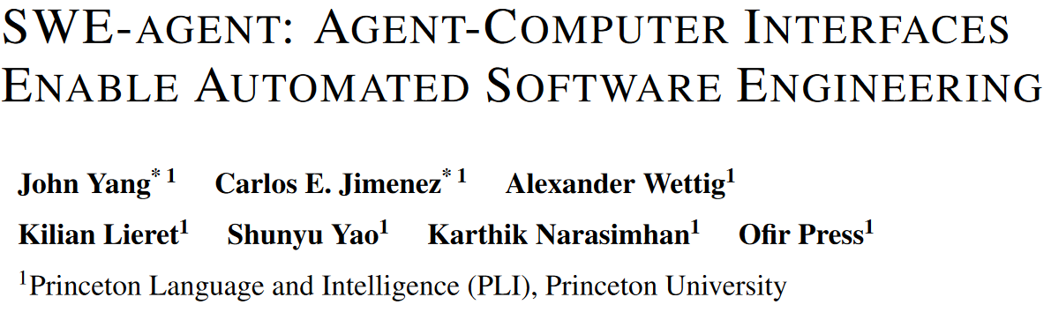

Slide 2
Abstract
Motivation SE tasks need both code generation and computer interaction.
Novelty A custom-built agent-computer interface for LM-computer interaction (code file creation and editing, repository navigating, program execution...)
Experiments On SWE-bench, SWE-agent solves 12.5% issues (SOTA: (RAG) 3.8%).

Slide 3
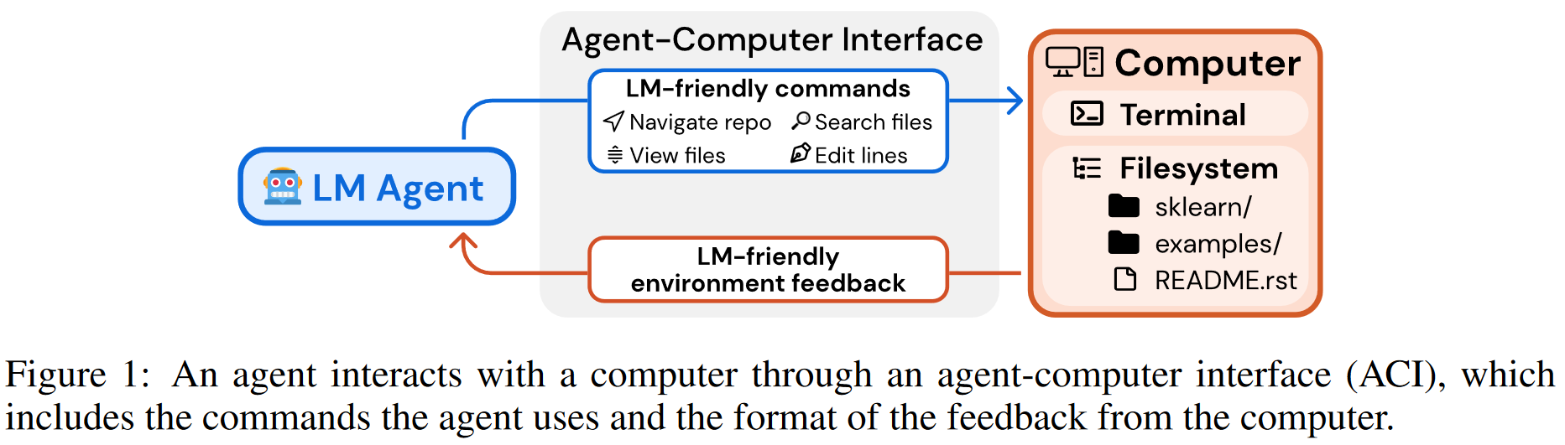
Introduction
LM interacting with computer environments Potential but less explored idea.

Slide 4
Introduction
Why do LMs need custom ACIs instead of existing UIs?
Existing UIs (e.g. shells, IDEs) are unsuitable for agents.
No efficient commands for small edits.
No feedback for successful action.
Accidental feedback can hurt LLMs' performance...
Experimental results show their performance.
Main contribution
Importance of Agent-Computer Interface design.
A SOTA system, SWE-agent, for real-world SE tasks.

Slide 5
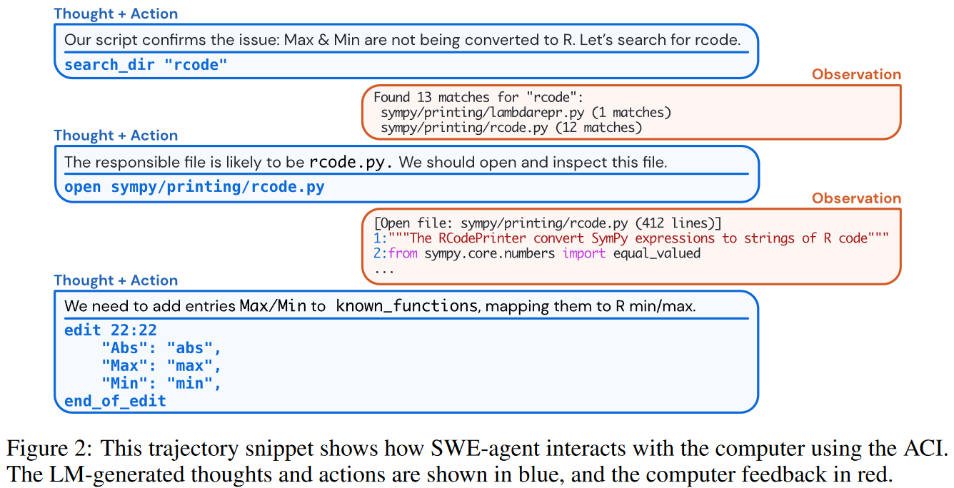
SWE-agent interaction example

Slide 6
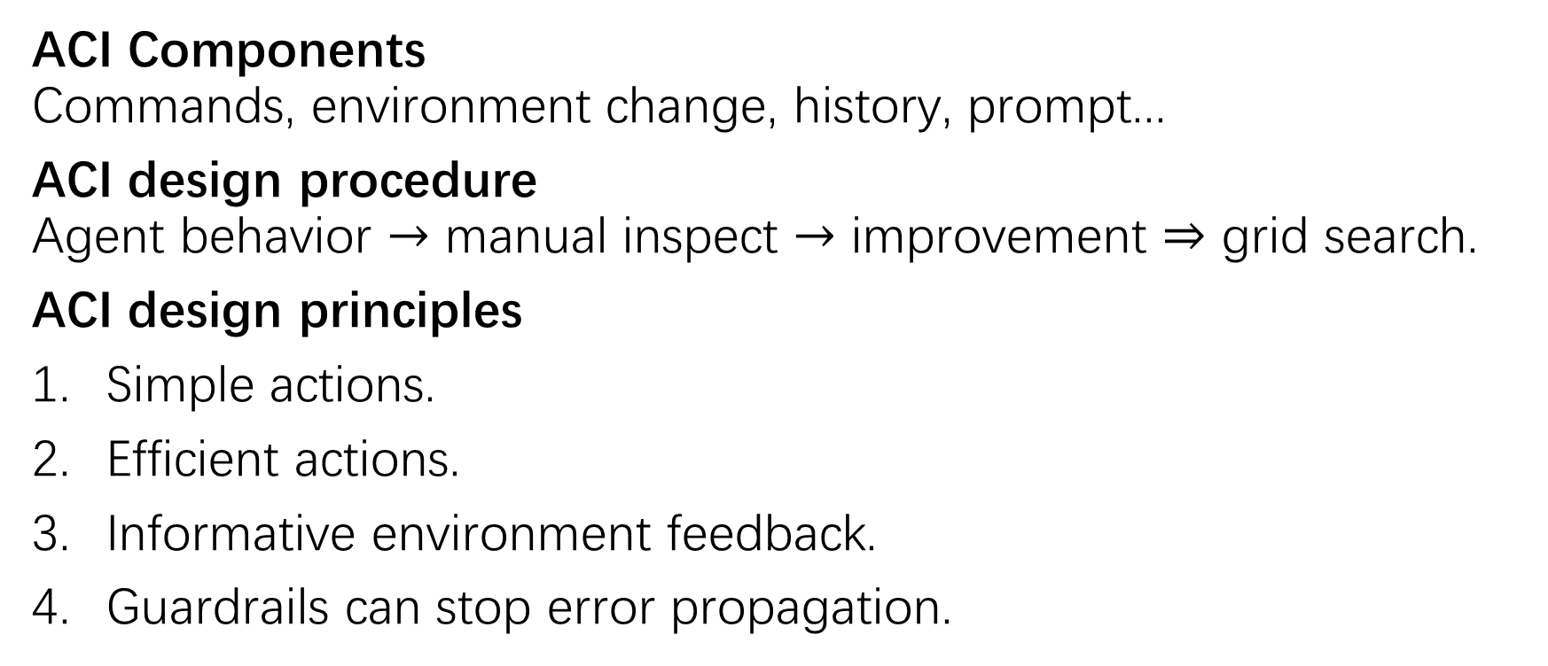
Agent-Computer Interface
ACI Components Commands, environment change, history, prompt...
ACI design procedure Agent behavior $→$ manual inspect $→$ improvement $⇒$ grid search.
ACI design principles
Simple actions.
Efficient actions.
Informative environment feedback.
Guardrails can stop error propagation.

Slide 7
SWE-agent interaction example
new commands
shell commands
extra success info

Slide 8
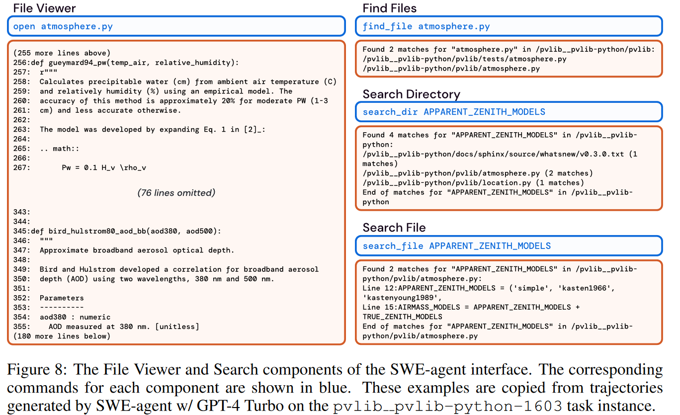


SWE-agent new commands
$≤100$ lines
$≤50$ results
scroll_up scroll_down goto

Slide 9
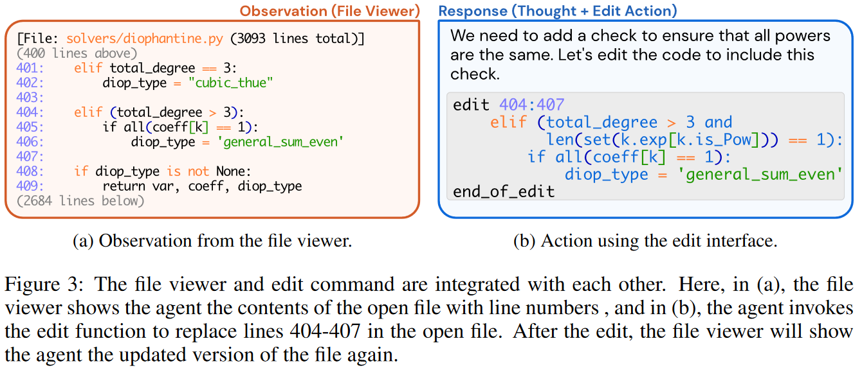
SWE-agent
Automatic linting
create

Slide 10
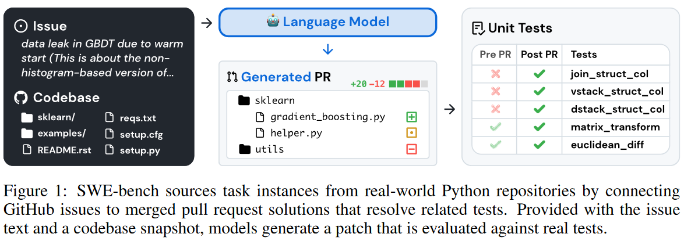
SWE-bench

Slide 11
Experimental setup
Models GPT-4 turbo gpt-4-1106-preview (128k context) Claude 3 Opus claude-3-opus-20240229 (200k context) $4 budget per instance.
Dataset SWE-bench SWE-bench Lite (subset; self-contained functional bug fixes)

Slide 12
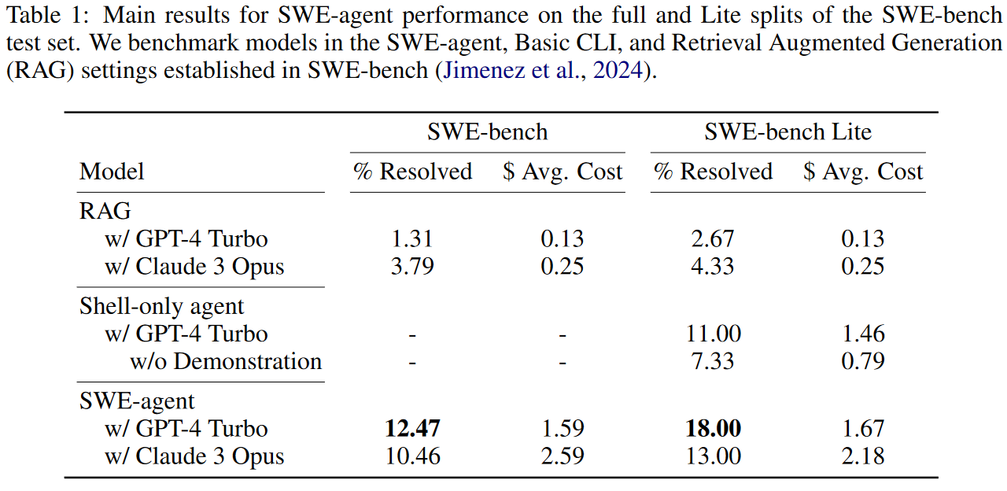
Experimental results

Slide 13
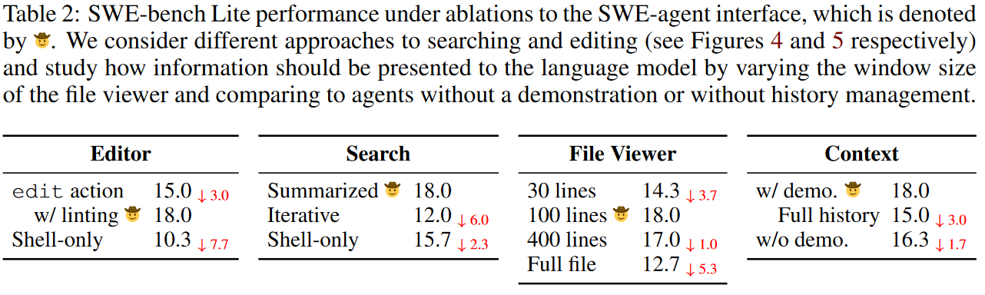
Ablation study results

Slide 14
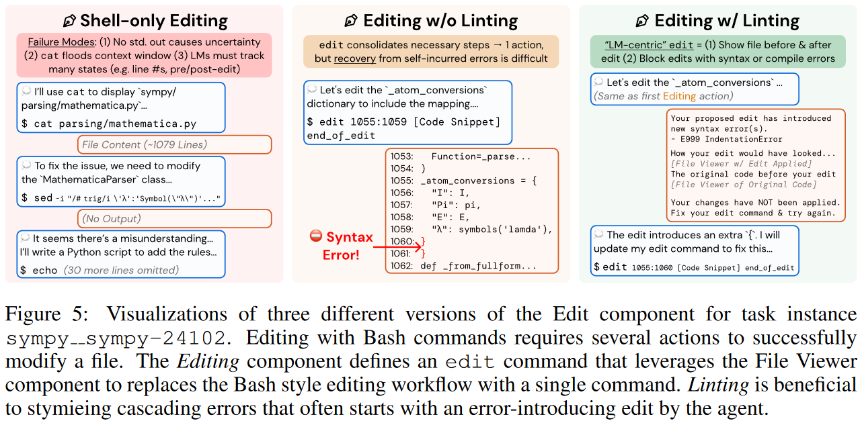
Edit variants

Slide 15
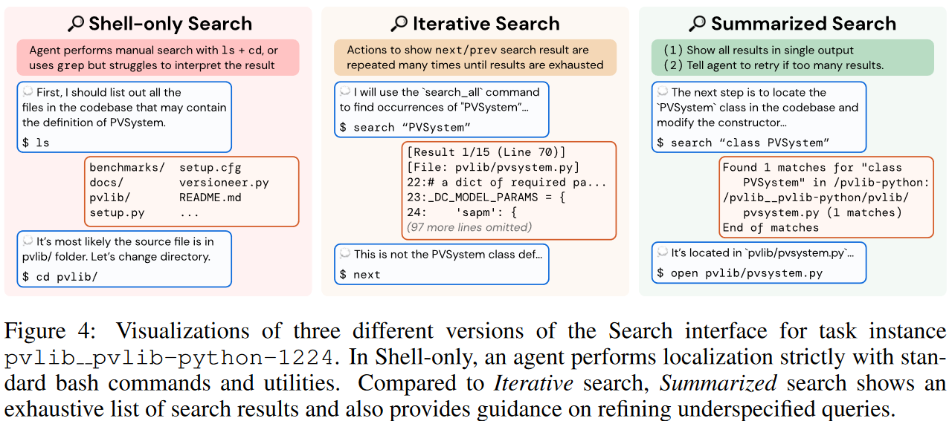
Search variants

Slide 16
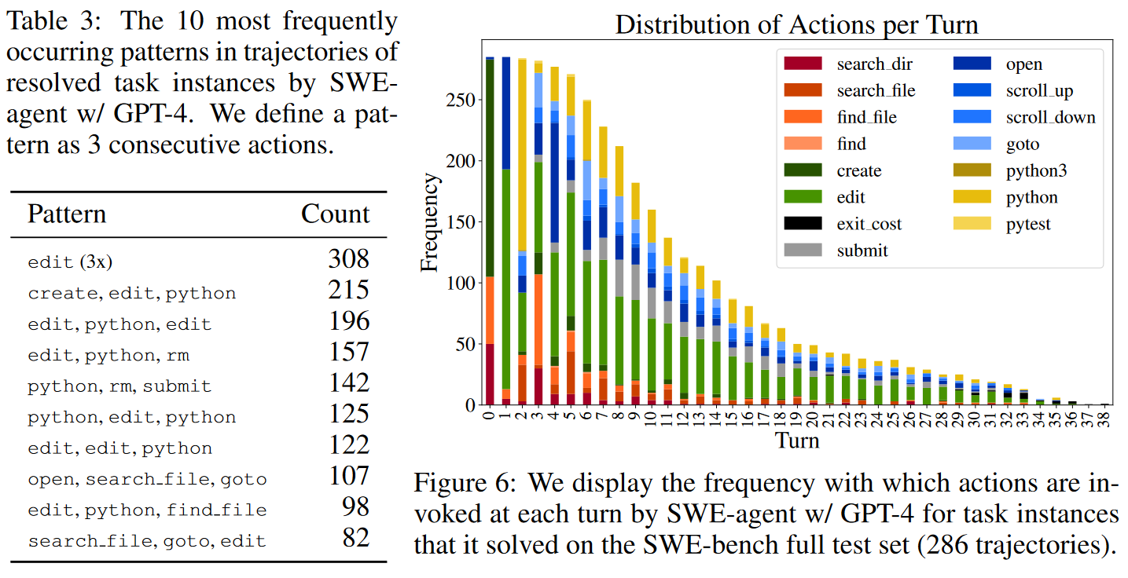
Agent behavior analysis
Edit + Run
Reproduction
Localization

Slide 17
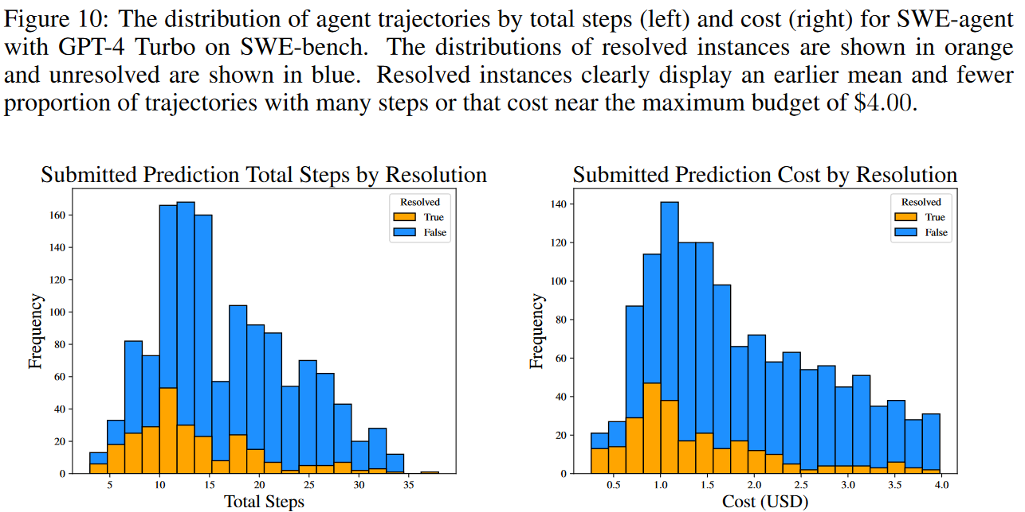
Agent behavior analysis

Slide 18
The End.

